Slide 1


CAD HW4 -
National Chiao Tung University Institute of Electronic Engineering
Modeling Mixed-Signal System and Simulating with AMS
Teaching Assistant: Hsin Tzu,Chao Date: 12/11, 2023
Lab: ED-413

Slide 2
Outline
Introduction to AMS
AMS Simulation Setup
Analog Simulation with Verilog-A Model
Mixed-Signal Behavioral Model Simulation
Lab1: Analog Model Simulation with AMS
Lab2: Mixed-Signal Model Simulation with AMS
Lab3: 4-bit ADC with Verilog-AMS

Slide 3
Outline
Introduction to AMS
AMS Simulation Setup
Analog Simulation with Verilog-A Model
Mixed-Signal Behavioral Model Simulation
Lab1: Analog Model Simulation with AMS
Lab2: Mixed-Signal Model Simulation with AMS
Lab3: 4-bit ADC with Verilog-AMS

Slide 4
What is AMS Designer
Top-down system-on-chip simulation for complex mixed-signal designs
A single executable simulator incorporating the fastest in digital and most flexible analog simulation capability
Digital: NC-Sim
Analog: Spectre
Simulation of complex designs incorporating any and all of the following:
Verilog, VHDL
Verilog-A, Verilog-AMS, VHDL-AMS
Spectre
SPICE
Composer schematics

Slide 5









What is AMS Designer(cont.)
NC-Sim
Spectre Analog Simulator
Digital Simulator
Verilog
Verilog-A
AMS
Mixed-Signal Simulator
Mixed Language Debugger
Waveform Display

Slide 6
Mixed-Signal Simulation with Model
The mixed-signal behavioral model simulation can verify:
System behavior is correct or not?
System requirement is met or not?
System performance is satisfied or not?
Weaknesses:
Only time domain information can be obtained directly
All behavioral model should be converted into time domain
Other characteristics might be calculated from time domain data

Slide 7
Outline
Introduction to AMS
AMS Simulation Setup
Analog Simulation with Verilog-A Model
Mixed-Signal Behavioral Model Simulation
Lab1: Analog Model Simulation with AMS
Lab2: Mixed-Signal Model Simulation with AMS
Lab3: 4-bit ADC with Verilog-AMS

Slide 8
Environment Setting
NC-Verilog / Verilog-XL
e.g > source /usr/cad/cadence/CIC/incisiv.cshrc
Spectre
e.g > source /usr/cad/cadence/CIC/mmsim.cshrc
Composer / Virtuoso
e.g > source /usr/cad/cadence/CIC/ic_06.17.709.cshrc

Slide 9
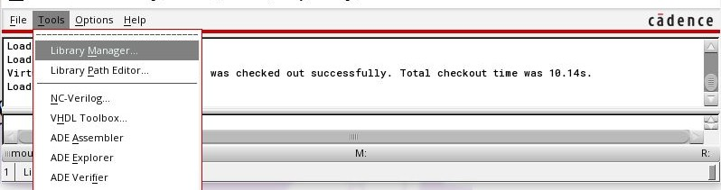
Simulation Flow
Step 1. > virtuoso &
Step 2. Open library manager
Create library
Create cell view & symbol
Verilog-A models
Verilog models
Schematic
Config
Set ADE
Open library manager

Slide 10

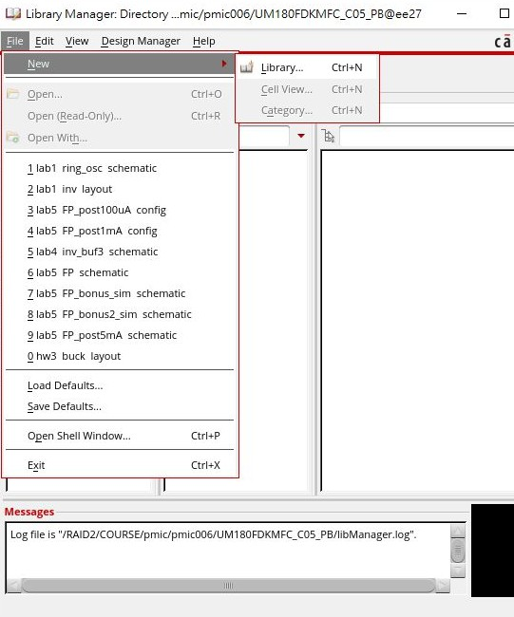
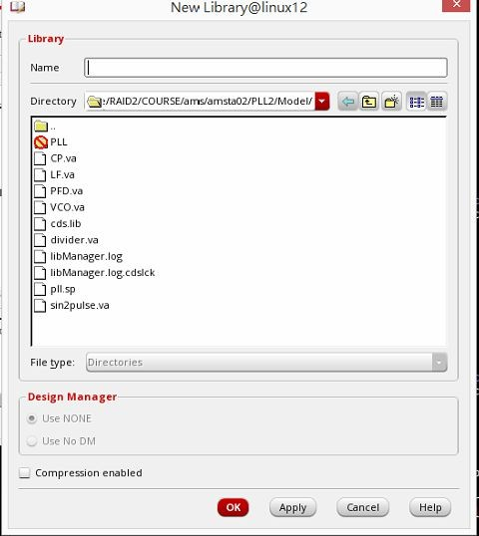
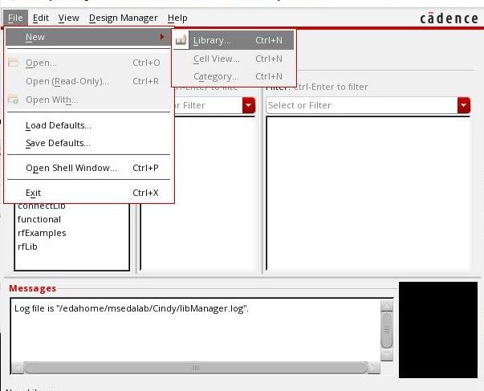

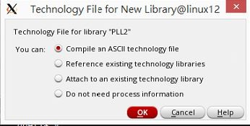
Simulation Flow
Create library
Create cell view & symbol
Verilog-A models
Verilog models
Schematic
Config
Set ADE

Slide 11
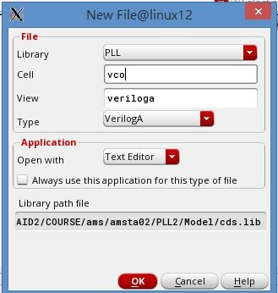

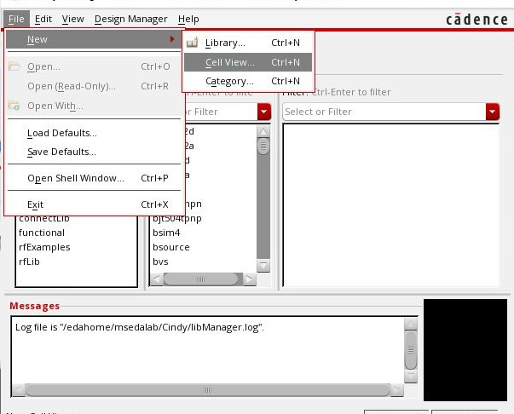
Create Verilog-A Cells
Create library
Create cell view & symbol
Verilog-A models
Verilog models
Schematic
Config
Set ADE
Create a new cell view
Choose your library
Input the name on the Cell Name column
Choose the VerilogA type for Analog model
OK

Slide 12
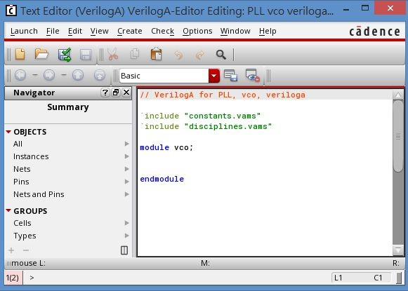
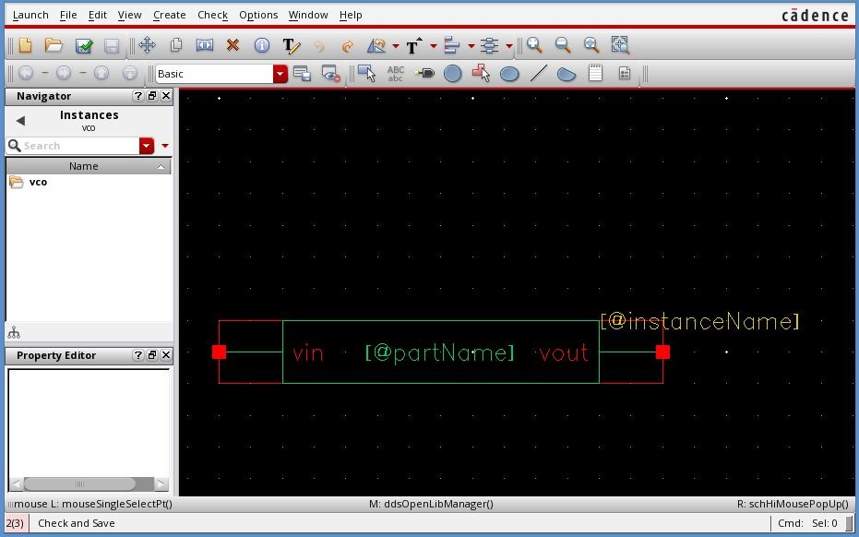
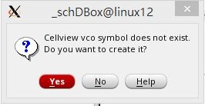
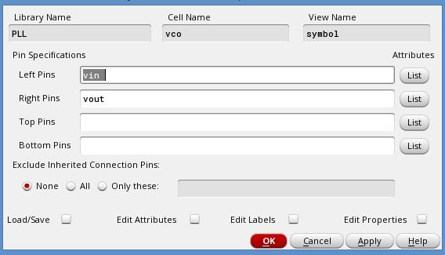

Designing with Verilog-A
Create library
Create cell view & symbol
Verilog-A models
Verilog models
Schematic
Config
Set ADE
Enter behavioral description
Mixed-Signal Electron
Automation Lab.
ic Design

Slide 13
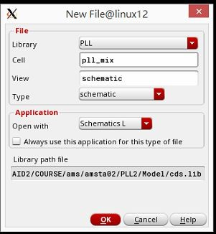
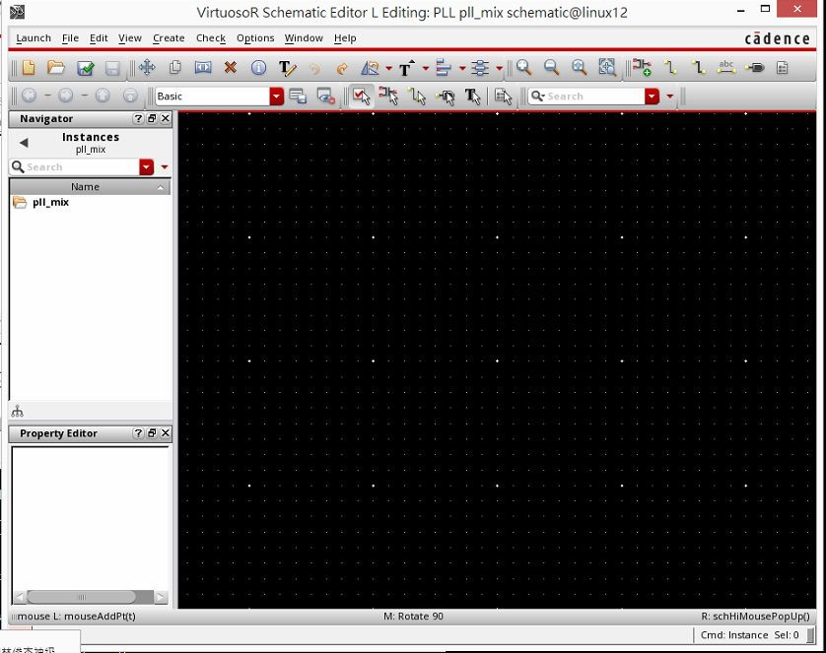
Create Top Cell - Schematic
Create library
Create cell view & symbol
Verilog-A models
Verilog models
Schematic
Config
Set ADE
Input the name on the Cell Name column and choose the Schematic

Slide 14
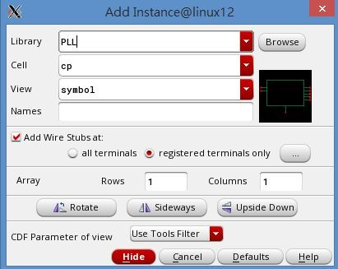


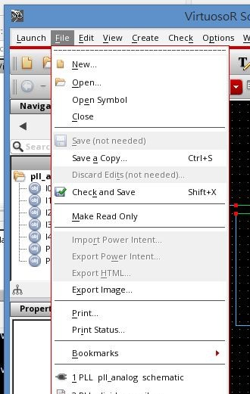
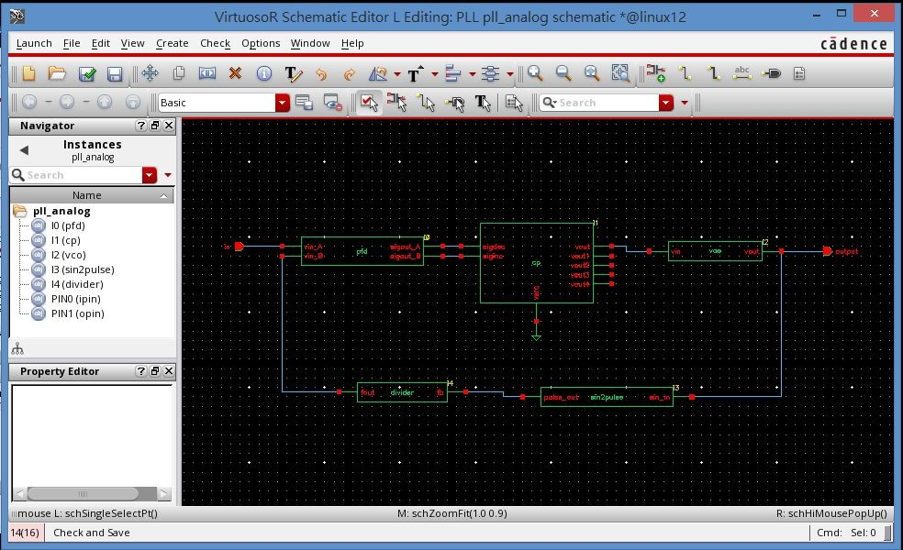


Create Top Cell - Schematic
Create library
Create cell view & symbol
Verilog-A models
Verilog models
Schematic
Config
Set ADE
Add Instance: Create→instance (i)
Add connection: Create → wire (w) Add input/output: Create → pin (p)
gnd in the“basic” library
Mix
Automation Lab.
ic De
ed-Signal Electron
sign

Slide 15
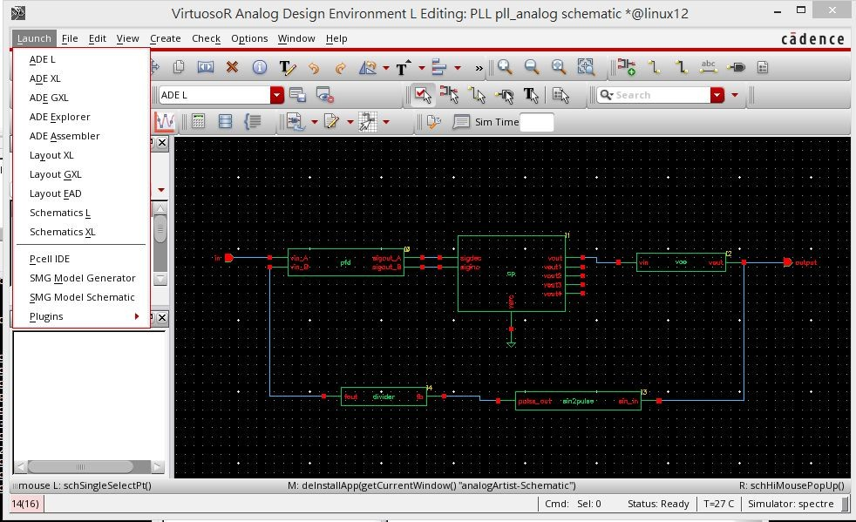
Simulation Environment
Open Analog Design Environment (ADE) in schematic editing window

Slide 16
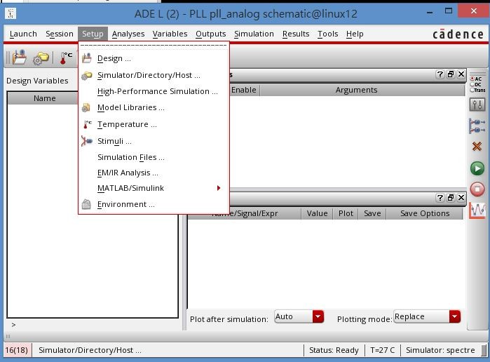

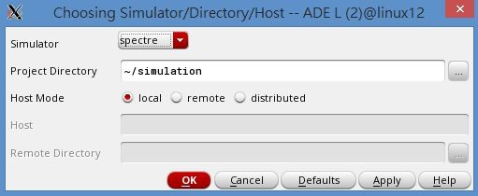
Through Setup -> Simulator/Directory/Host
Analog => spectre Mixed-Signal => AMS

Slide 17
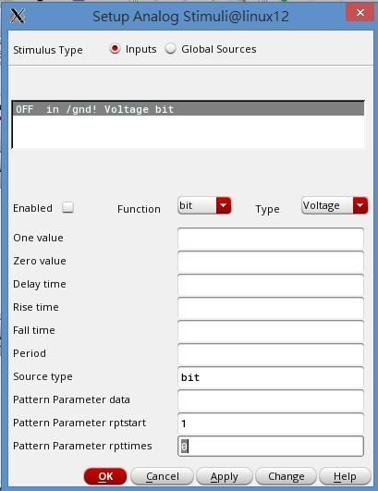

Give input information(1/2)
Input pin name in schematic
If choose spectre as simulator, there only has stimuli

Slide 18
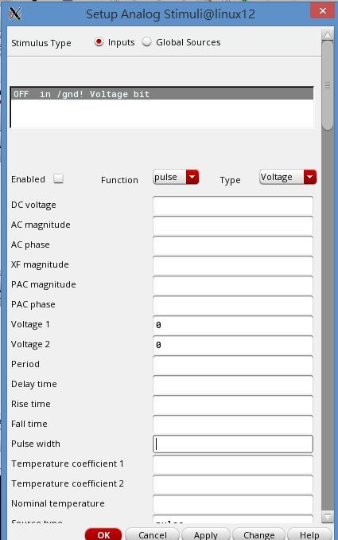
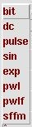
Give input information(2/2)
Voltage1:1.8V Voltage2:0V Period:20n Pulse width:10n
1
.
Check enable
2
.
Input high voltage and low voltage
3
.
Input pulse width and period Pulse width =1/2 period

Slide 19
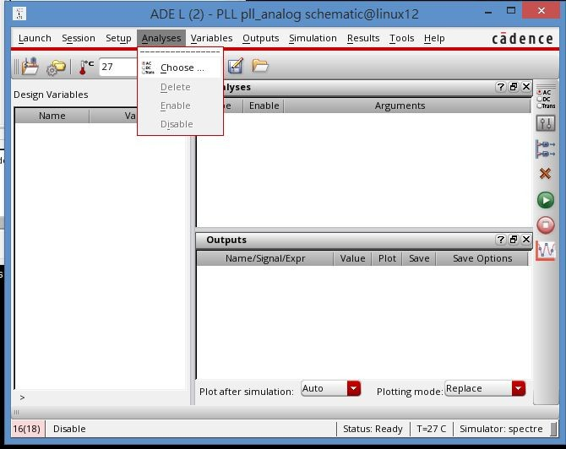
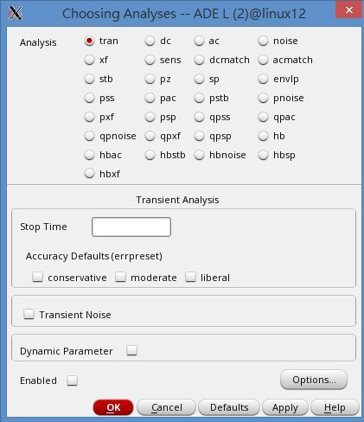
Choose Analysis Type
Choose tran analysis
6u
Set the simulation time
and the accuracy flag
Check enable to simulation

Slide 20
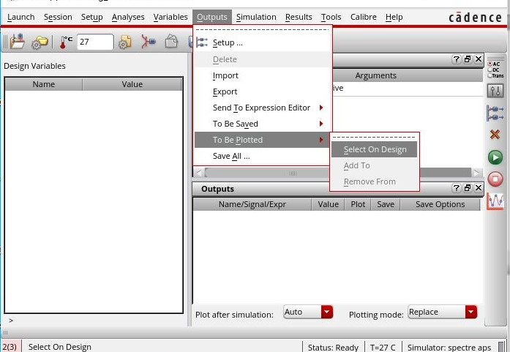
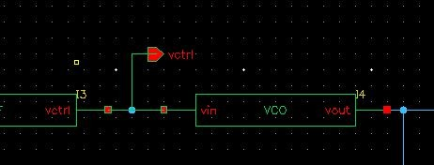
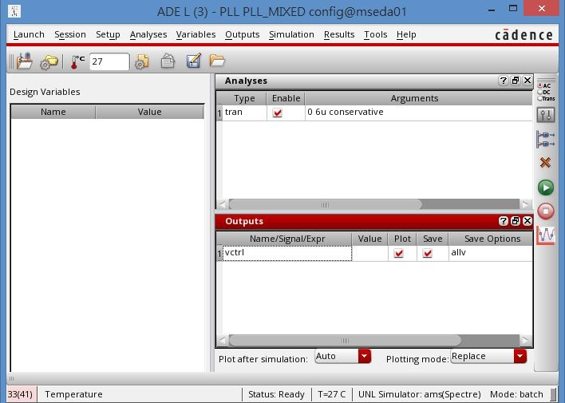
Save Output Nodes
To Be Plotted:
Select on line or node
Press Esc to cancel

Slide 21
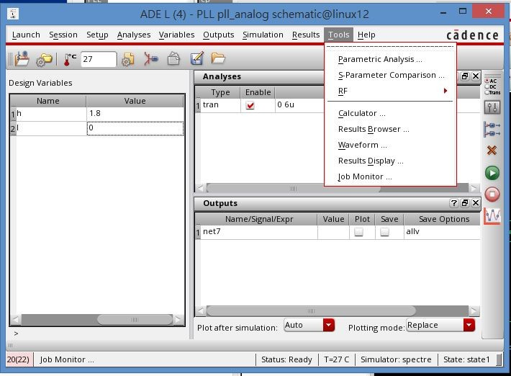
Submit the Simulation
Execute the simulation job with Run
Tools → Results Brower
2.
1.
Mixed-Si
gnal Electronic Design
Automation Lab.

Slide 22
Outline
Introduction to AMS
AMS Simulation Setup
Analog Simulation with Verilog-A Model
Mixed-Signal Behavioral Model Simulation
Lab1: Analog Model Simulation with AMS
Lab2: Mixed-Signal Model Simulation with AMS
Lab3: 4-bit ADC with Verilog-AMS
Mixed-Signal Electronic Design
Automation Lab.

Slide 23

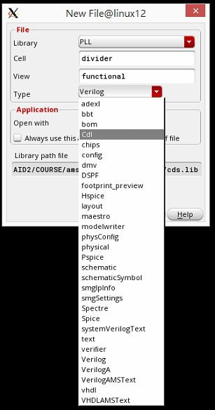
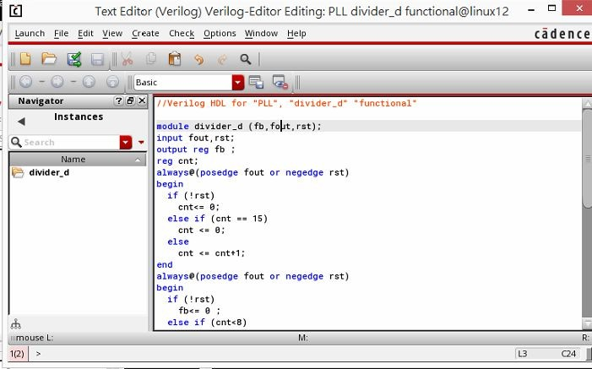

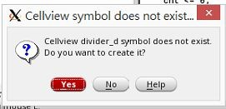
Create Verilog Cells
Create library
Create cell view & symbol
Verilog-A models
Verilog models
Schematic
The cell name must be the same
Config
Set ADE
Mixed-Signal Electronic Design
Automation Lab.

Slide 24















Design Hierarchy – AMS
Before creating the top schematic cell (add instance and connection), creating a config view for AMS simulation
Top Cell
<schematic>
Cell
Cell instance
<functional>
Cell instance
instance
<Verilog-A>
<schematic>
Cell instance
<Verilog-AMS
Cell instance
<Verilog-A>
Mixed-Signal Electronic Design
>
Automation Lab.

Slide 25
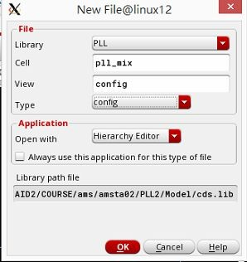


Create Config View for Simulation
The mixed-signal simulation hierarchy is controlled by
Hierarchy-Editor
It must have to be defined in the config cell view.
Cell name is top schematic cell for simulation
Choose config type

Slide 26
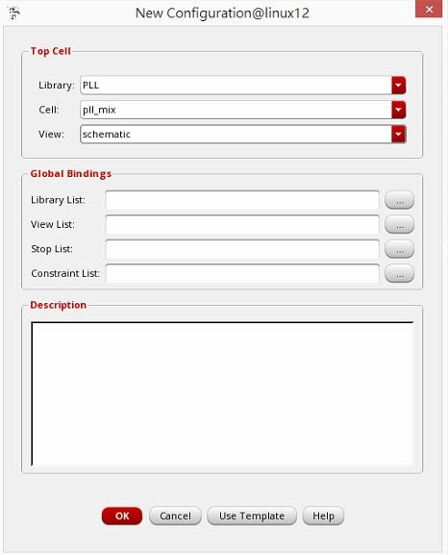
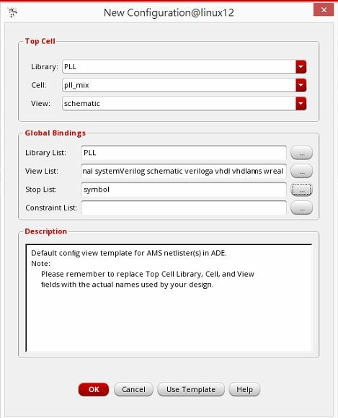

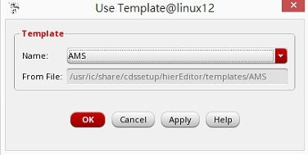

Set New Configuration
Select schematic view of top cell
change to your library
Bottom view
Select AMS simulator in template

Slide 27
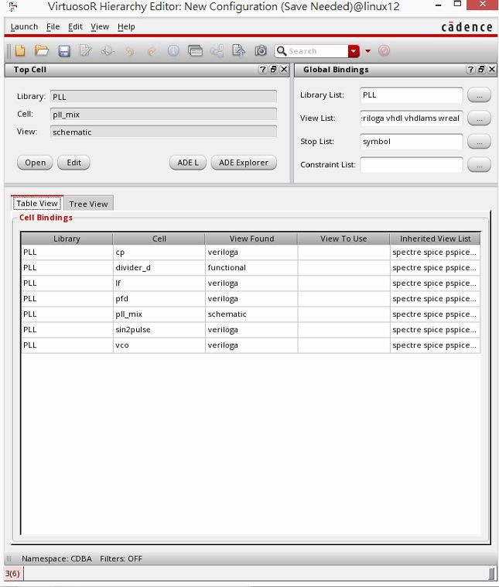

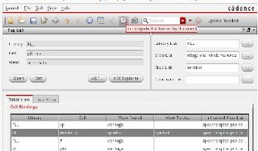
Configuration Setting
The hierarchy-editor will list all cells and views in the cell bindings
Must to save and recompute!
Mixed-Signal Electronic Design
Automation Lab.

Slide 28
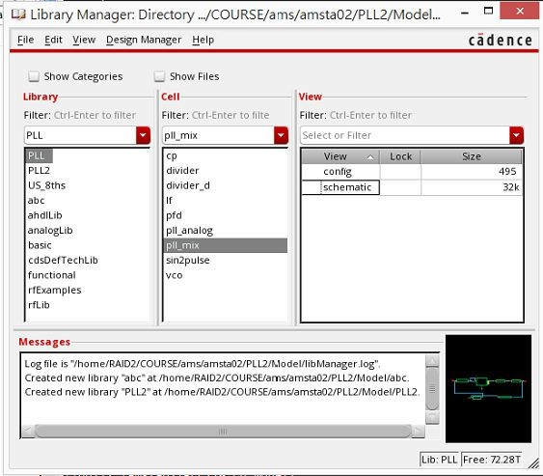
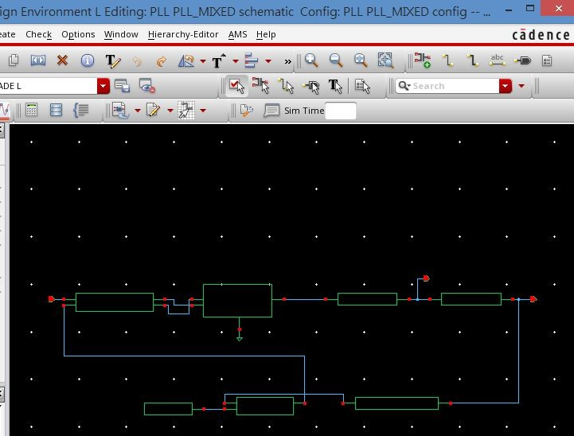
Open Simulation Tool
Finish create config
Click config at library manager to open simulation tool
The simulation steps are the same as analog
Except give input information
Confirm the title has “config”

Slide 29
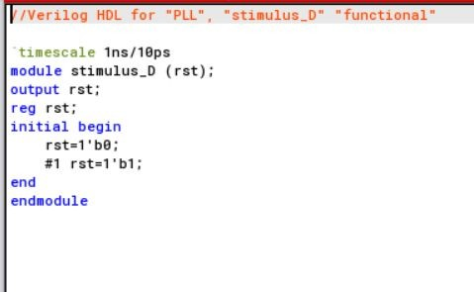
Digital Stimulus
Create a behavioral or functional view for the stimulus block
The stimulus (Verilog) could be created to symbol view as the same procedure with digital cell

Slide 30
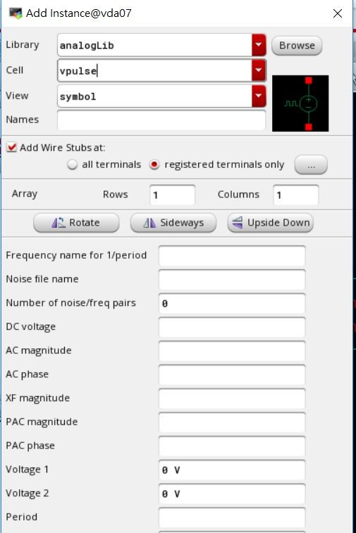
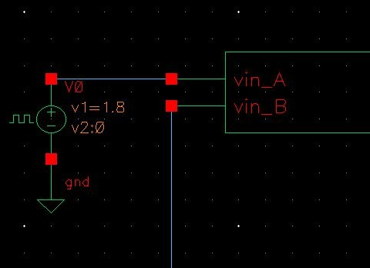
Analog Stimulus
The analog stimulus can be added as circuit instance
Add Instance
Choose analogLib
& vpulse cell
Set voltage & frequency

Slide 31
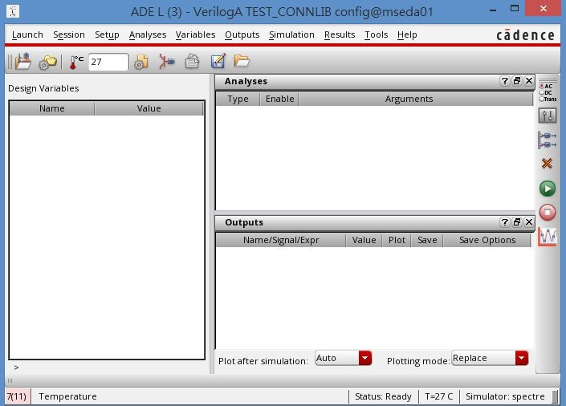
1. Setup
✔ Simulator choose AMS
Analysis
✔ Tran analysis
✔ Set simulation time and enable
Outputs
✔ Save all or select on design
Run
Waveform viewer

Slide 32
Outline
Introduction to AMS
AMS Simulation Setup
Analog Simulation with Verilog-A Model
Mixed-Signal Behavioral Model Simulation
Lab1: Analog Model Simulation with AMS
Lab2: Mixed-Signal Model Simulation with AMS
Lab3: 4-bit ADC with Verilog-AMS

Slide 33
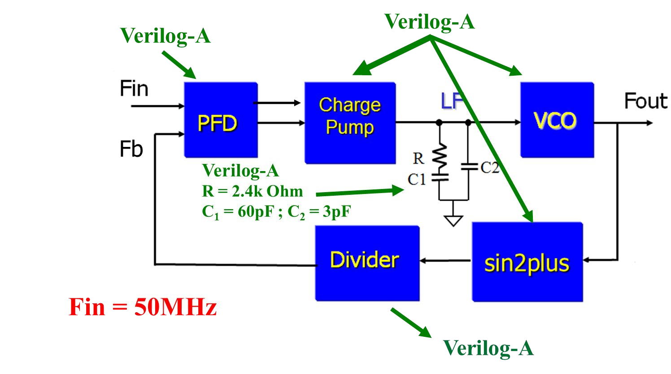
PLL Analog Model
All Verilog-A models are given
PFD, CP, LF, VCO, sin2plus, divider
Import the Verilog-A models and setup ADE

Slide 34
Additional Description
Connection
Connect up (sigout_A) signal of PFD to siginc signal of CP
Connect dn (sigout_B) signal of PFD to sigdec signal of CP
Connect in signal of divider to sin2pulse
Charge pump(CP)
Connect vsrc to GND
VDD = 1.8V GND = 0V
Simulator: spectre
Input
Fin=50M Hz : Set the ADE Stimuli
Simulation time ≧ 6μs
Related to the lock time of PLL

Slide 35
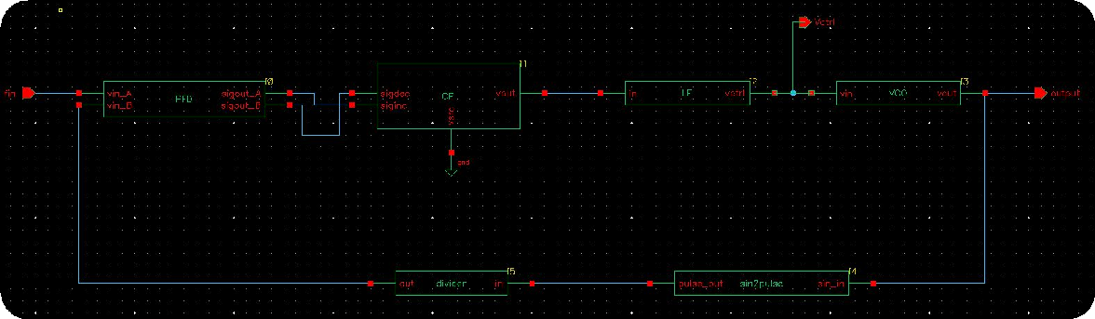

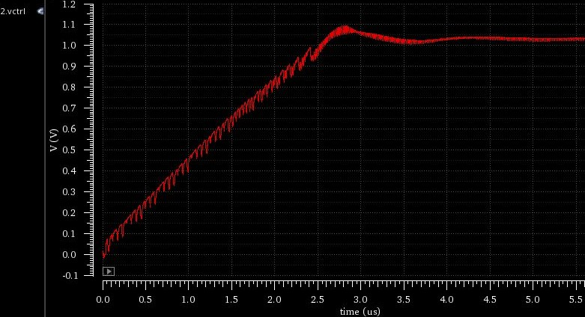
Results
Show the waveform of vctrl signal and schematic
view
Top schematic cell
Observe the waveform of Vctrl
Open Results Brower

Slide 36
Outline
Introduction to AMS
AMS Simulation Setup
Analog Simulation with Verilog-A Model
Mixed-Signal Behavioral Model Simulation
Lab1: Analog Model Simulation with AMS
Lab2: Mixed-Signal Model Simulation with AMS
Lab3: 4-bit ADC with Verilog-AMS

Slide 37
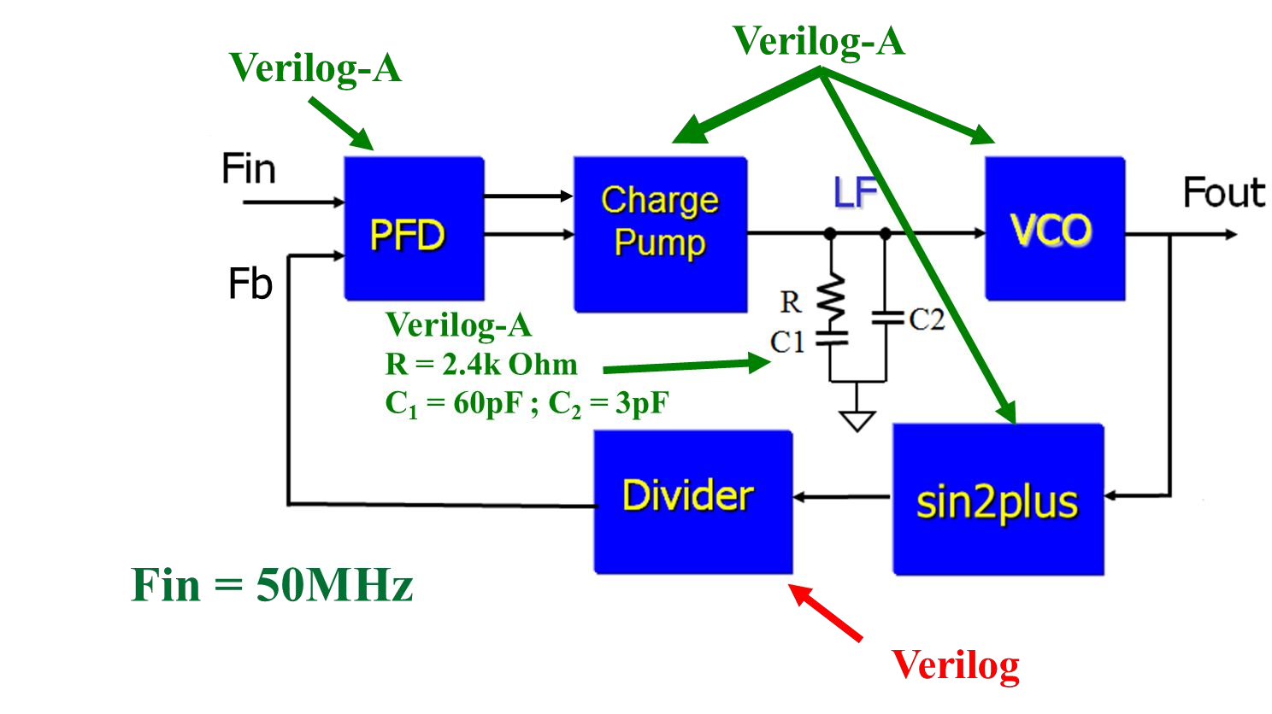
PLL Mixed-Signal Model
All models are given
Analog model (Verilog-A): PFD, CP, LF, VCO, sin2plus
Digital model (Verilog): divider
Import all models and create a testbench
Testbench : generate rst signal for divider
Test bench
rst

Slide 38
Additional Description
Connection
Connect up (sigout_A) signal of PFD to siginc signal of CP
Connect dn (sigout_B) signal of PFD to sigdec signal of CP
Connect in signal of divider to sin2pulse
Charge pump(CP)
Connect vsrc to GND
VDD = 1.8V GND = 0V
Simulator: AMS
Input
Fin=50M Hz, Adding voltage source instance
Simulation time ≧ 6μs
Related to the lock time of PLL

Slide 39
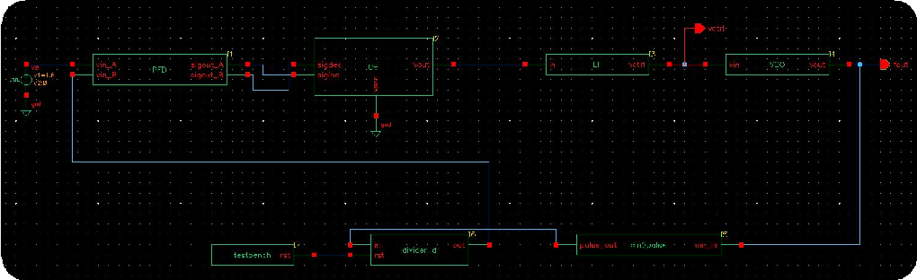
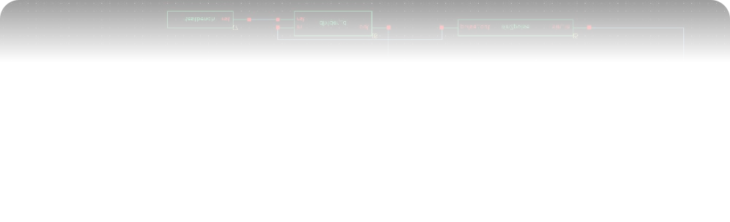
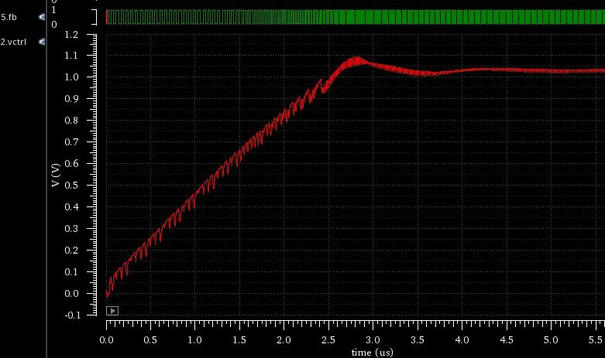
Results
Show the waveform of vctrl, output of the divider and schematic view
Top schematic cellview
Observe the waveform of Vctrl
Open Results Brower
Observe the output of divider.v

Slide 40
Outline
Introduction to AMS
AMS Simulation Setup
Analog Simulation with Verilog-A Model
Mixed-Signal Behavioral Model Simulation
Lab1: Analog Model Simulation with AMS
Lab2: Mixed-Signal Model Simulation with AMS
Lab3: 4-bit ADC with Verilog-AMS

Slide 41

Description
Vref = 8V
input = 3.5V
7V
6V
0
5V
0
0
0
1
1
1
0
4V
3V
2V
1
1
1V

Slide 42


Type : AMS
Support output reg

Slide 43
Parameters of ADC Model
Input : sin wave
Amplitude : 16V, Frequency : 20M
Output : 4 bit output
R=0.5k, Vref=16V
Analysis Type : tran, 125n
Simulator: AMS
B3,B2,B1,B0 (bit) | Input (V)
0000 | 0
0001 | 1V
0010 | 2V
0011 | 3V
0100 | 4V
0101 | 5V
0110 | 6V
0111 | 7V
1000 | 8V
1001 | 9V
1010 | 10V
1011 | 11V
1100 | 12V
1101 | 13V
1110 | 14V
1111 | 15V

Slide 44

Results
Hand in:
The waveform of outputs of comparators, encoder and input
Schematic cellview

Slide 45
Hand in
Please upload a compressed file includes:
Programming files (Verilog and Verilog-A files)
Lab2: Stimuli (testbench.v)
Lab3: Encoder file(.vams or .v), comparator file(.vams or .va)
Mini report
Three simulation waveforms
Lab1: Analog simulation (Vctrl)
Lab2: Mixed-signal simulation (Vctrl & output of the divider)
Lab3: ADC (outputs of comparators, encoder and input)
Three schematic cellviews
What you have learned from this homework
Questions and solutions
Deadline: 23:55, December 31, 2023

